Slide 1
Beam Dumping System and Abort Gap
LHC Beam Commissioning Workshop
Evian 19 -20 January 2010
Session 4: Machine Protection Systems
Jan Uythoven TE/ABT
For the LBDS and Abort Gap Teams

Slide 2
Outline
Performance of the Beam Dumping System
  Some Operational Statistics
Beam Dumping System ‘Failures’ and Issues
  Kicker systems
  XPOC
    Operational Experience
Beam Dump Aperture and Trajectory
Abort Gap Cleaning
  Experience so far
  Is it ready for higher intensities and higher energies?
Conclusions
  Are we ready for higher intensities and higher energies?
  Outstanding issues
Only 10 minutes from the Chairman

Slide 3
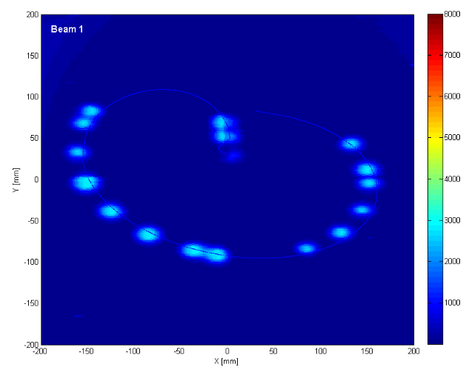
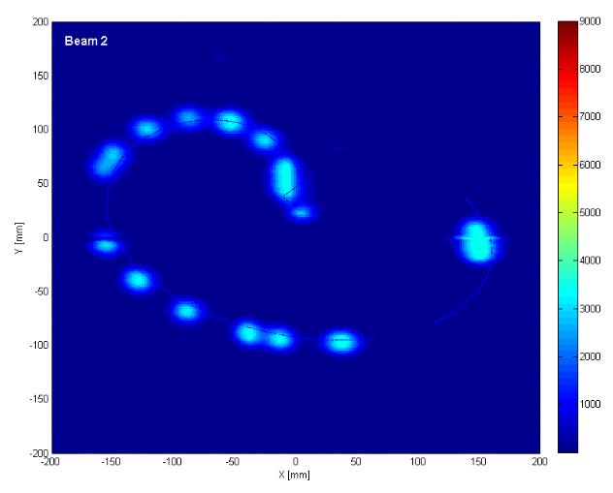
Beams for physics dumped, at the right place! 450 GeV
Beam dumps, 16 bunches + pilot, 14/12/09 around 21:00
BTVDD image = position on beam dump block TDE
Comparison with calculated positions from measured kicker magnet waveforms.

Slide 4
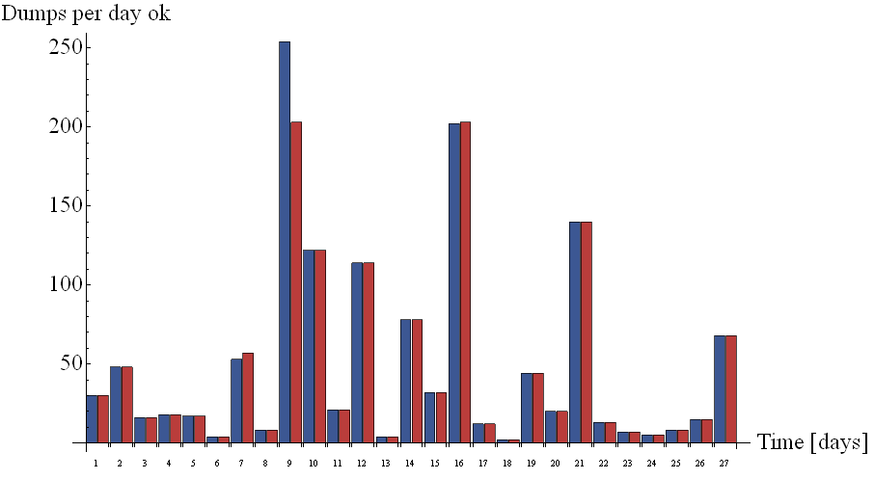
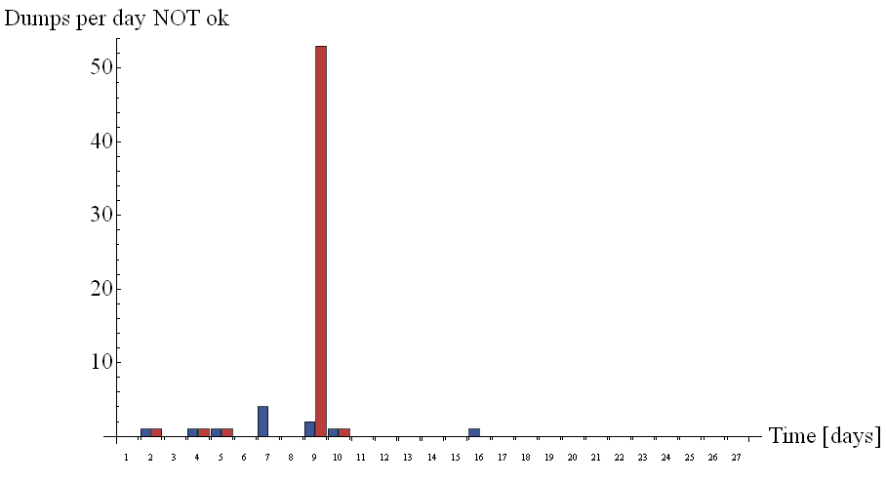

XPOC Statistics Beam 1
Number of times dump triggered
XPOC = eXternal Post Operational Check
MKB (dilution) only 1 x false XPOC during Synch.-Asynch Dump
 | OK | Not OK | Total
XPOC1 | 1355 | 11 | 1366
XPOC2 | 1309 | 57 | 1366
Energy | 450 GeV | 600 GeV | 1200 GeV
# Dumps | 1358 | 1 | 7
27 days from 20 Nov. to 16 Dec.
MKD = beam dump extraction kicker
MKD Gen. K pulse length.
Limit enlarged. OK.
See later.
No false last 10 days

Slide 5
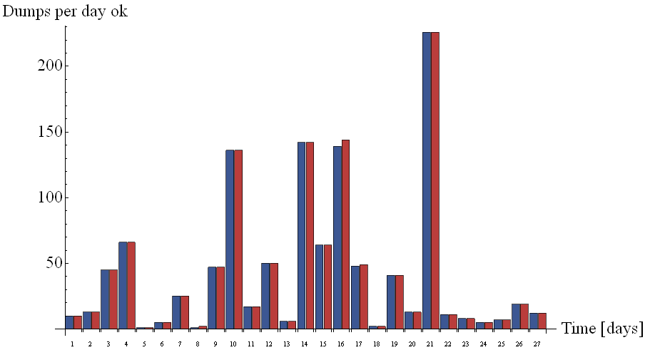
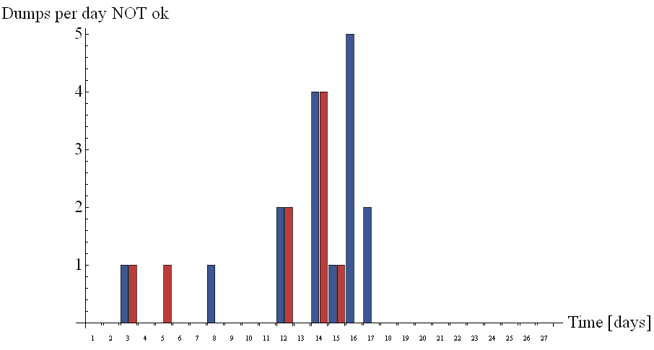

XPOC Statistics Beam 2
MKB no false XPOCs
 | OK | Not OK | Total
XPOC1 | 1159 | 16 | 1175
XPOC2 | 1166 | 9 | 1175
Energy | 450 GeV | 600 GeV | 800 GeV | 1200 GeV
# Dumps | 1159 | 1 | 1 | 7
27 days from 20 Nov. to 16 Dec.
Most errors due to ‘Energy Error’ in XPOC analysis.
See later. Fixed.
XPOC 1 errors due to noisy signal. See later. Fixed.
No false last 10 days

Slide 6
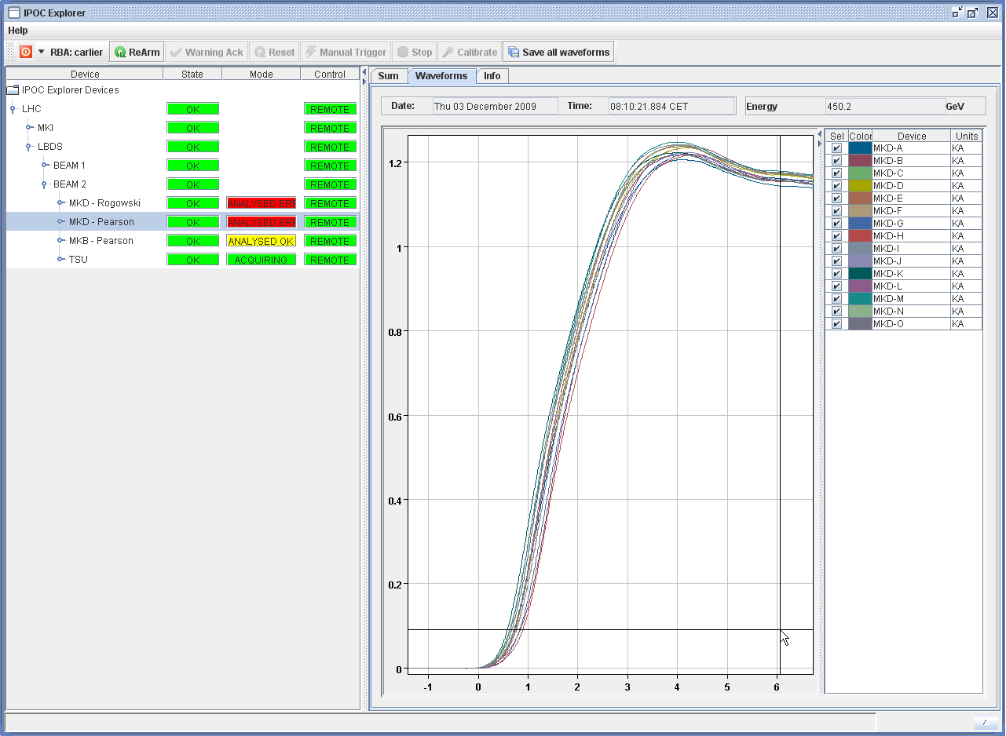
Beam Dumping System ‘Failures’
All dump ‘failures’ were caught by the XPOC and/or IPOC system
There were no beam dump failures which were ‘unacceptable’
  Protected against asynchronous dumps with TCDQ
  Would normally expect about 1 asynchronous dump per year
However, 11 ”Synchronous-Asynchronous” dumps due to problem with TSU
Dump request received during the 1.5µs F_{rev} pulse duration
  Dump request inhibited for the current turn
Original inhibition mechanism lets a “glitch” going out
  Synchronous trigger of the 15 kicker generators
  Asynchronous trigger w.r.t. the circulating beam
TSU firmware upgraded and successfully tested
- Generator synchronisation OK
- Kick delay w.r.t. beam abort gap FAULTY

Slide 7
Other Beam Dump System Hardware Problems
2 x fuse on MKB power trigger converter broken
  Needed access to change – no safety issue
  Reduced the power consumption of converter in this Techn.Stop
BPM signal used for synchronisation: 2µs off-set
  Being checked…
Resistors used for re-triggering in case of MKD switch conduction not via stack: 15/60 broken
  Masked in the generator interlock
  Still one per generator active, but no redundancy left
  For this reason we should not operate present system above 5 TeV and high beam intensities
    Switch erratics issue above 5 TeV,
    More important after installation of generator cooling = dry air
  Replacement resistors available in some wks, need about 2 wks for swap
Reliability of Pelletier cooling of MKD generators
  Some failures of cooling, but still ok because little heating at low energies
  Gives interlock when outside ± 1 °C temperature range

Slide 8
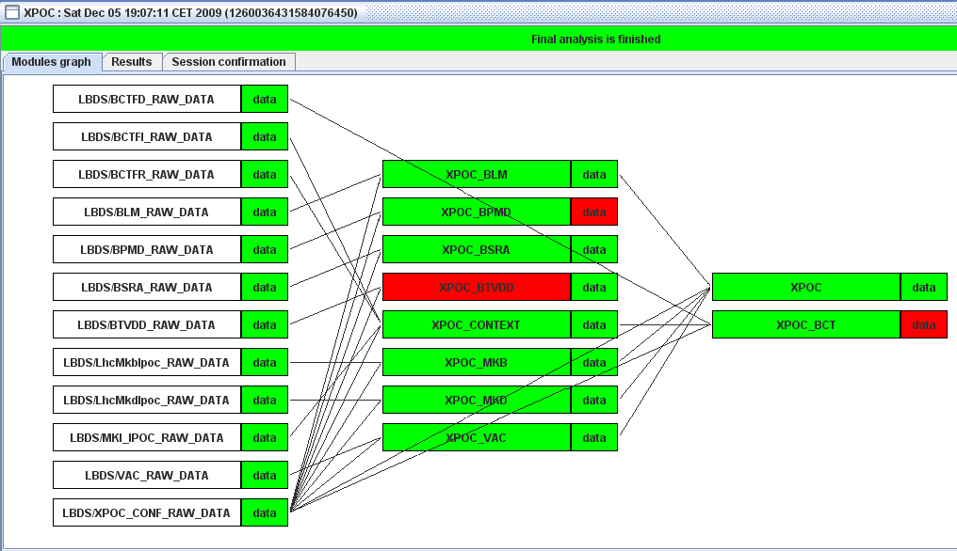
LBDS XPOC: eXternal Operational Check
Operational modules at the end of operation:
  MKD and MKB kickers
  Vacuum
  Beam loss monitors: proven to trigger in case there is beam in the abort gap at the moment of dump
Modules present, but not interlocking – need more work and time to commission
  Beam dumped current
  – BCTD
  BTVDD image
  BPMD
  Abort Gap Monitor
Working within the
PM framework
General BI checks to be
deployed (BTVDD,
BCTD etc.)

Slide 9
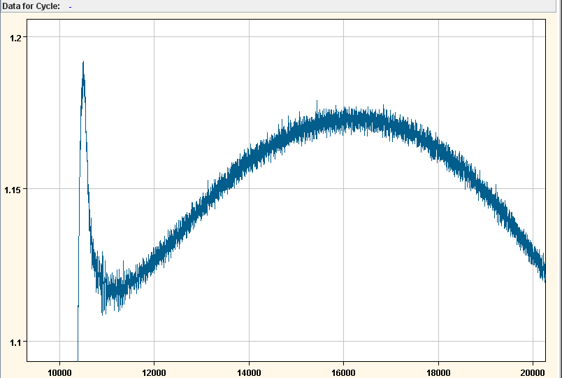
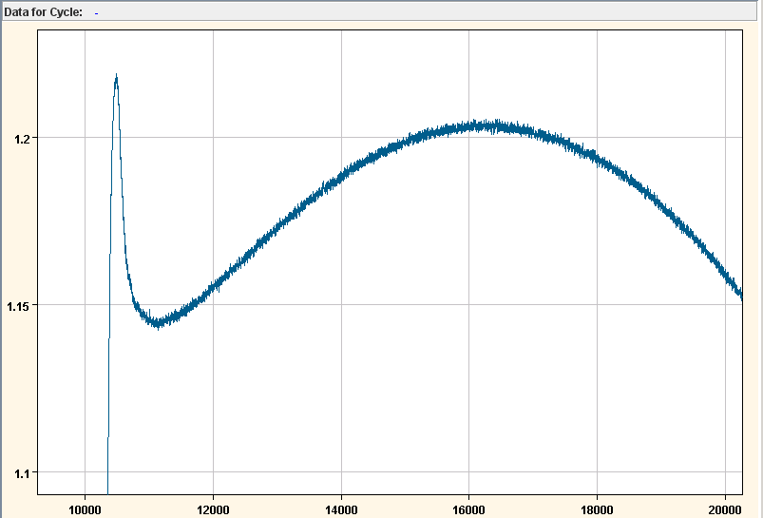
False XPOC / IPOC results
…. Signaling a REAL hardware Problem I
Synchronisation errors due to TSU problem
  Real problem – solved
MKD XPOC1
  Analysis based on Rogowski current measurement which is known to be more noisy than the Pearson signal used for XPOC2
  Occasional bad XPOC1
  OK after doubling the acceptance window
As the systems are redundant, this is acceptable
Raw SDDS data XPOC1
Raw SDDS data XPOC2

Slide 10
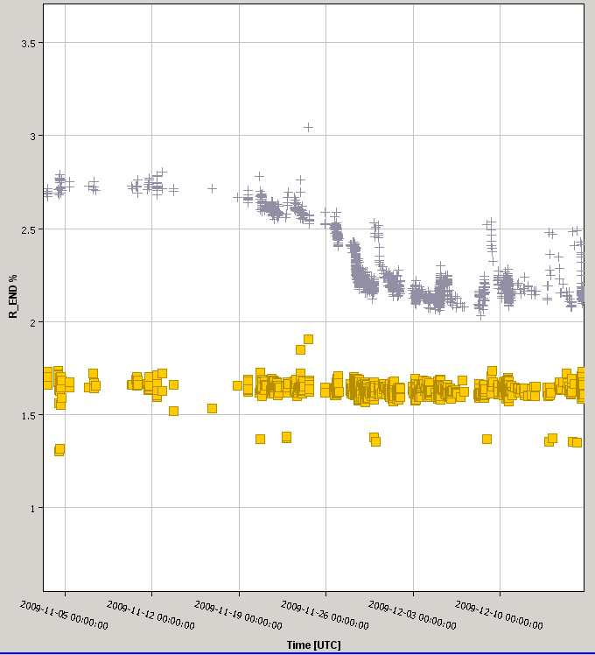
False XPOC / IPOC results
…. Signaling a REAL hardware Problem II
MKD Beam Generator K
  Varying pulse length
  – ‘sign of something changing’
  Under investigation in this Technical Stop
K-reference value
Original limit
MKD B1 Generator K,
Pulse length drops during operational period but ‘jumps back’ when dumps at 1.2 TeV
Lim.
Enlarged limit
G-Ref.
Lim.
MKD B1 Generator G,
for comparison
5 Nov
12 Dec

Slide 11

False XPOC / IPOC results
…. Signaling an XPOC / IPOC Problem
XPOC sequencer task picking up different time stamps from MKD and MKB IPOC
  Solved during operation by applying the correct tolerance
XPOC MKD analysis failed because of different energies
  Solved during operation by applying the correct tolerance
IPOC MKD analysis failed, giving some analysis points ‘dangling in the air’
  Solved during in Technical Stop by small change in algorithm (same problem as for MKI IPOC used for IQC)
These false XPOCs were annoying for both the operators and the experts, however I’m convinced that we have to maintain the Expert Reset for XPOC, as the LBDS is too safety critical.

Slide 12
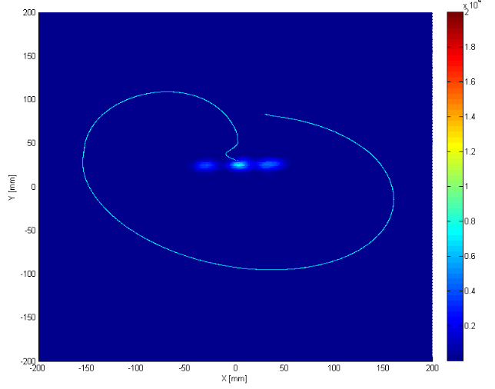
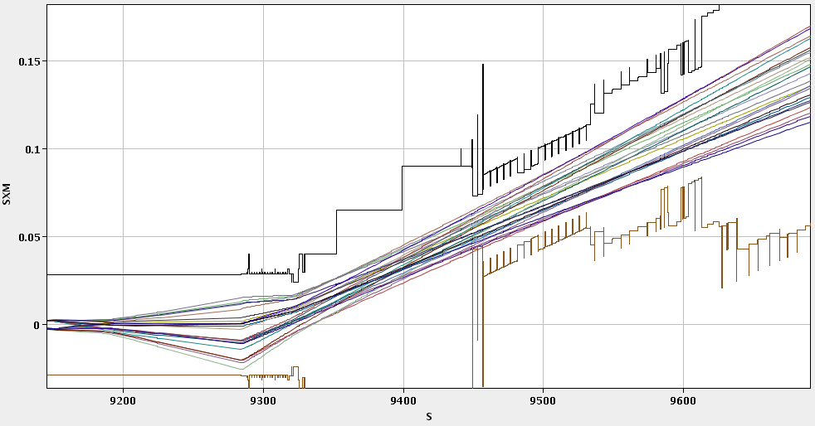
Beam Dump Channel Aperture
Aperture limits measured with all phases in H and V plane for B1 and B2 → as expected
MSD
MKD
Can dump without losses with ±1.67 MKD for B1, +1.333 and -1.67 MKD for B2. Spec: + 0, -1 MKD.

Slide 13
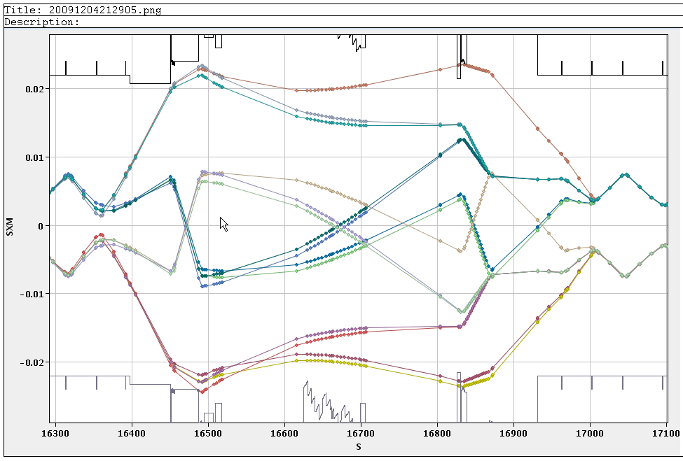
Point 6 – Circulating Beam Aperture
Circulating beam aperture in H and V for B1 and B2 checked carefully at TCDS, TCDQM, MSDC and MKD, with bumps through the region → beam lost where expected
“Official aperture model”
IR6 H Beam2, circulating
TCDQM
MSD
TCDQM

Slide 14
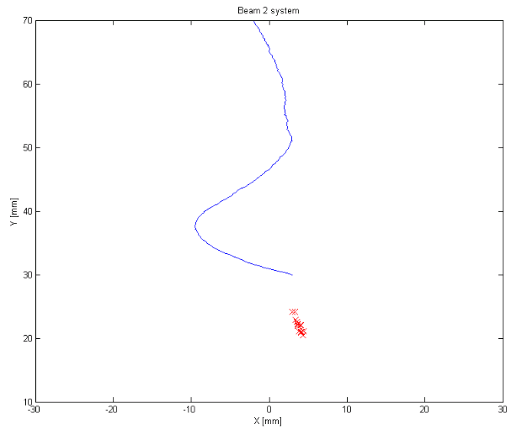
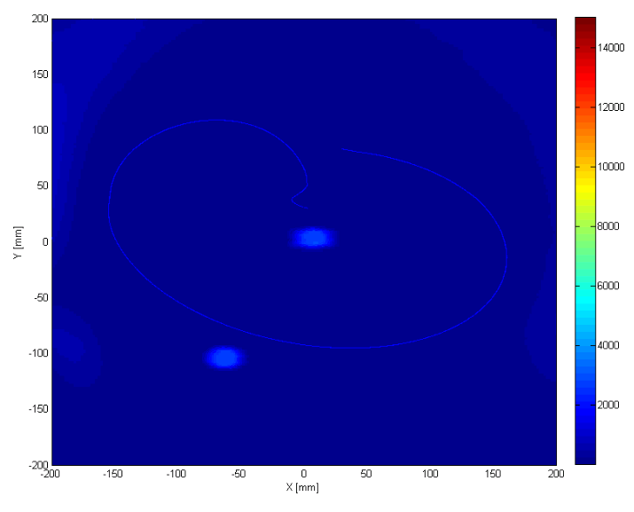
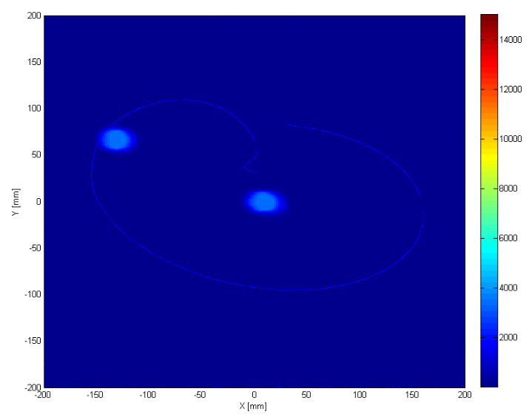
Dump at 1.2 TeV
Vertical dump position low at
1.2 TeV for both beams
  After orbit correction to golden orbit
  Maybe 7-8 mm vertical error at the TDE
  for both beams
  Can be an MSD calibration issue?
    About 11 µrad too weak
Beam2 bucket 1 from golden orbit
B1
B2

Slide 15
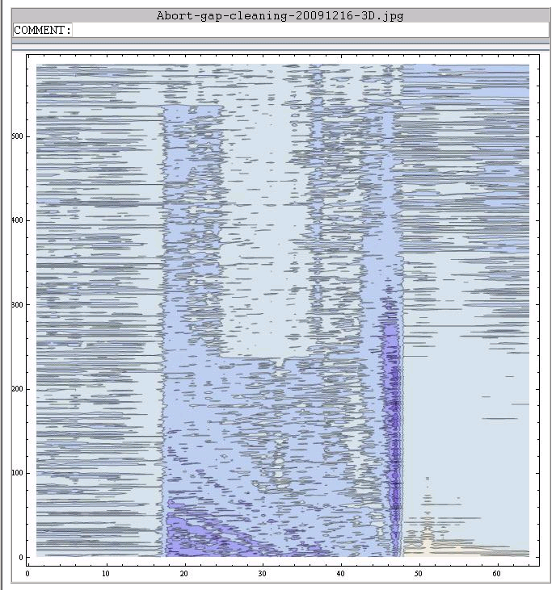
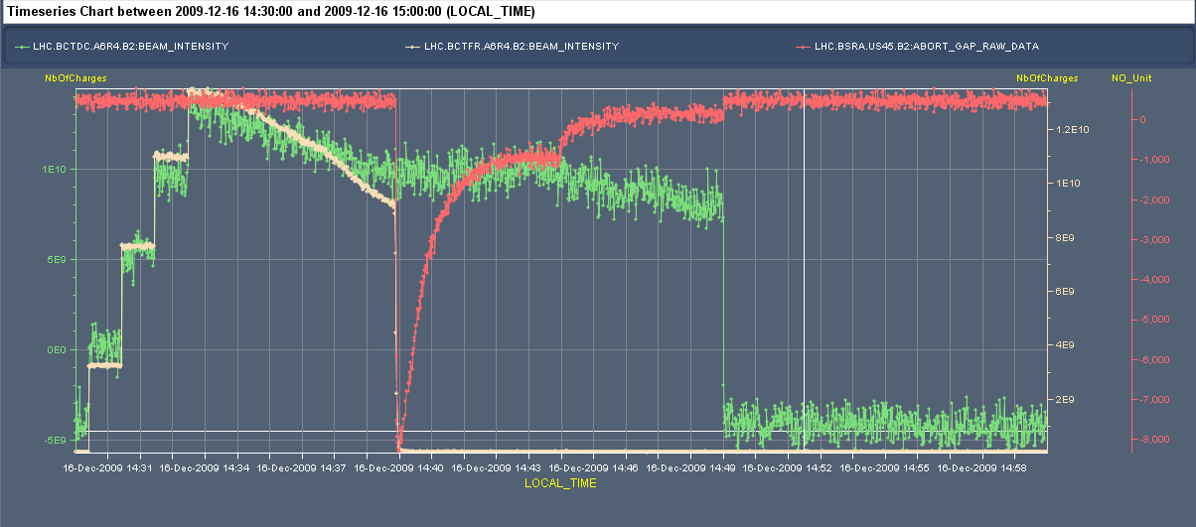
Abort Gap Cleaning Tests
First functionality tests performed on December 15-16, 2009
Used vertical dampers on beam 2
BSRA data show gap partially cleaned
RF-Off:
BCTFR signal to 0
BCTDC signal flat
BSRA signal pops up and reduces when beam disperses
Cleaning on:
BCTDC signal shows losses = cleaning
BSRA signal decreases from previous equilibrium to new equilibrium
Beam Dumped:
BCTDC to 0
BSRA to 0
Losses at BLMs at TCDQ / TCDS, at moment of dump, are reduced to about 10 – 12 % relative to no cleaning!

Slide 16
Conclusions on Abort Gap Cleaning
Undulator and synchrotron light monitor successfully commissioned for beam 2
  Beam 1 remains to be commissioned
Abort Gap Cleaning “works” already during first tests!
  But needs to be further optimised to clean over the full 3 µs while limiting the losses outside the abort gap
  About 10 % of the beam was left in the gap
Concerning Machine Protection we will need to commission the Abort Gap Monitoring Interlock
  Interlock values to be found and tested with beam

Slide 17
Conclusions / Are we Ready for Higher Intensities and Higher Energies?
The beam dumping systems worked very well and the XPOC and IPOC systems caught all failures
  Only real failures were the Synchronous-Asynchronous dumps: solved after TSU firmware upgrade
  Opening up of XPOC1 window and one MKD generator which drifted
  Other XPOC/IPOC ‘false’ were software issues, sorted out during the 2009 run
Many tests with beam outstanding
  Dump at intermediate energies, already some energies ‘missing’ up to 1.2 TeV
  Follow commissioning procedures for increasing energy and intensity: edms 896392
Sort out vertical dumped beam position on TDE (MSD calibration?)
Should not pulse with unsafe beam above 5 TeV without redundancy on resistors for erratic trigger protection (new ones ordered)
Further BI-XPOC modules to be commissioned
With the present ‘habits’ and possibilities to skip sequencer tasks, the SIS latching is mandatory
  At some point the SIS interlock of the XPOC will have to become unmaskable
We will need to converge to a more standard way of running sequences and clear instructions which tasks are mandatory to be run before each injection or each fill and under which conditions tasks can be skipped: PROCEDURES – Master Sequence
BSRA – Abort Gap Monitoring Interlock to be commissioned and tested with beam
  Abort Gap cleaning also needs further commissioning, but should not be a machine safety issue

Slide 18
Acknowledgements
Many thanks to the LBDS and Abort Gap Teams: B.Goddard, E.Carlier, N.Magnin, N.Voumard,T.Kramer, W.Bartmann, V.Kain, R.Allemany Fernandez,V.Mertens, M.Meddahi, L.Ducimetière, A.Antoine, F.Castronuovo, F.Olivieri, D.Khasbulatov, V.Baggiolini, J.Axensalva, S.B.Pedersen, A.Boccardi,A.Butterworth, A.S.Fisher, E.Gianfelice-Wendt, G.H.Hemelsoet, W.Höfle, D.Jacquet, M.Jaussi, T.Lefevre, E.Shaposhnikova, D.Valuch and many others.

